Slide 1
GIT HUB
MINI PROJECT
DHIVYA.K
21CSR041

Slide 2
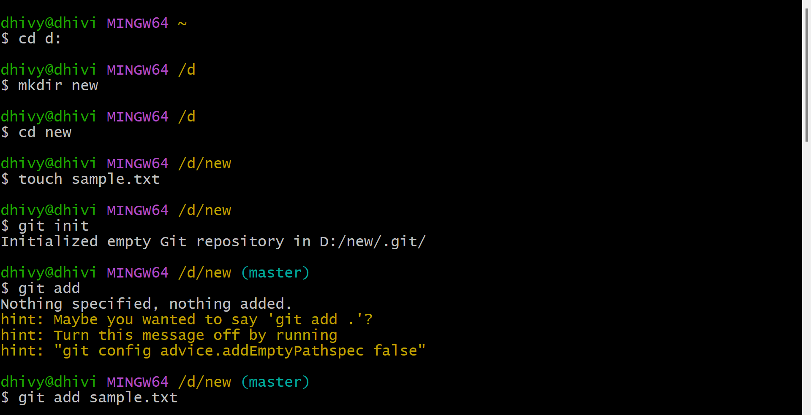
1. Initialize Git local repository and add file “sample.txt”

Slide 3
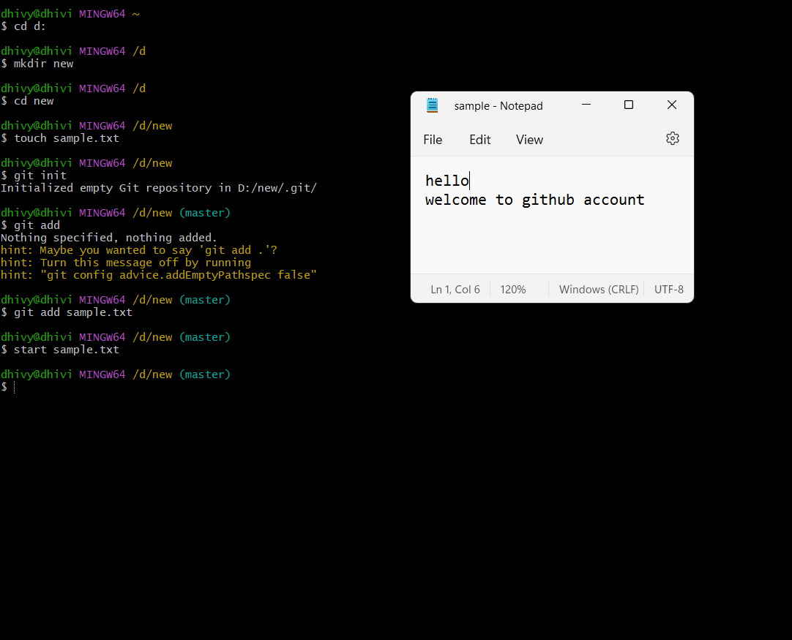
2. Make some changes to “sample.txt” and do first commit.

Slide 4
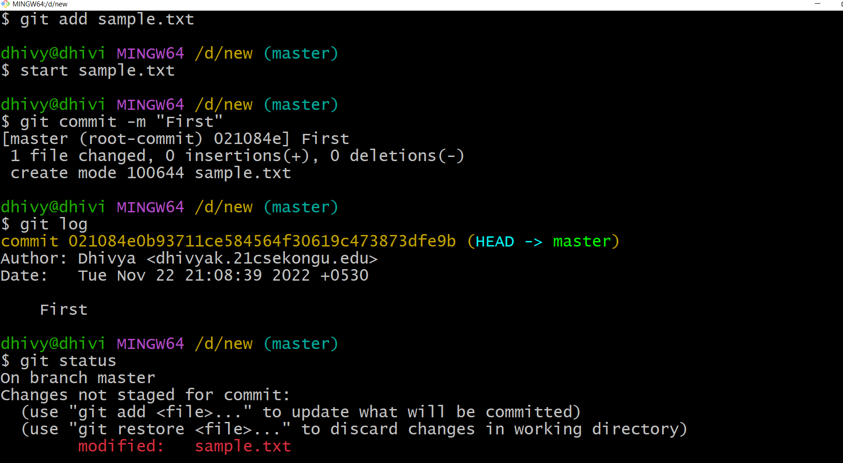

Slide 5
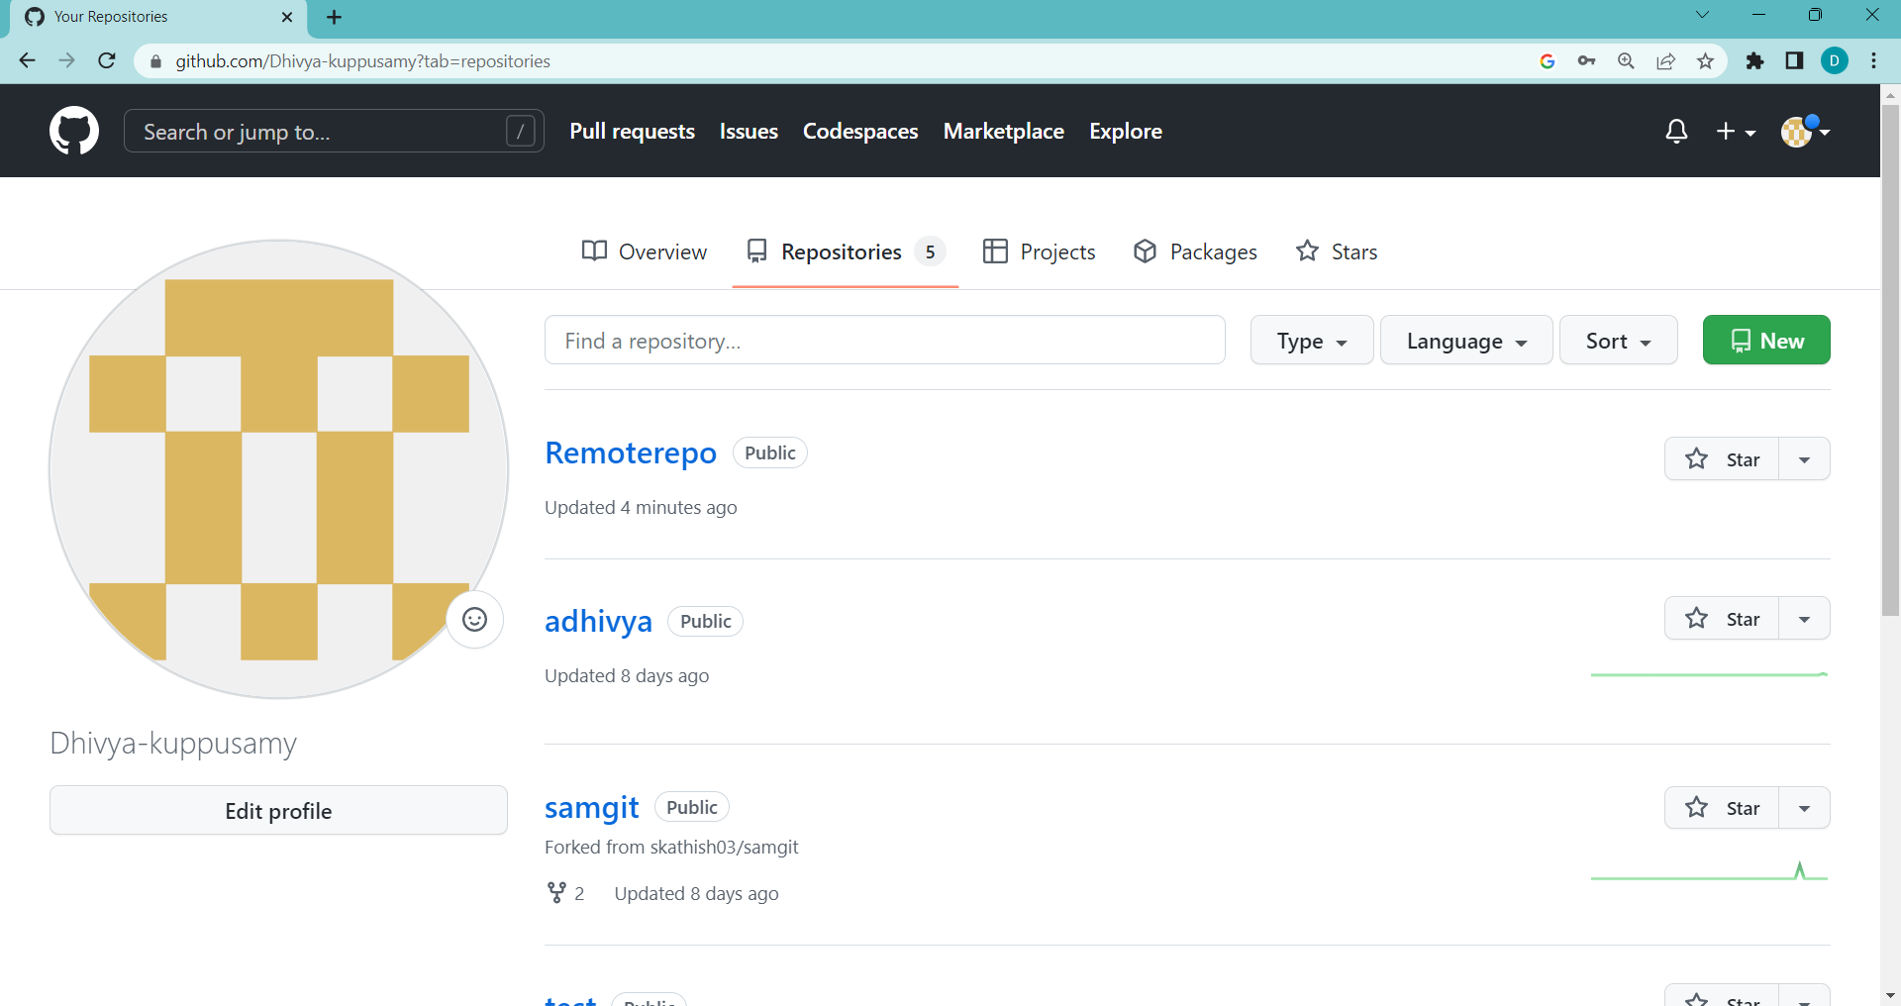
3. Create remote repository named “Remoterepo” in github.com.

Slide 6
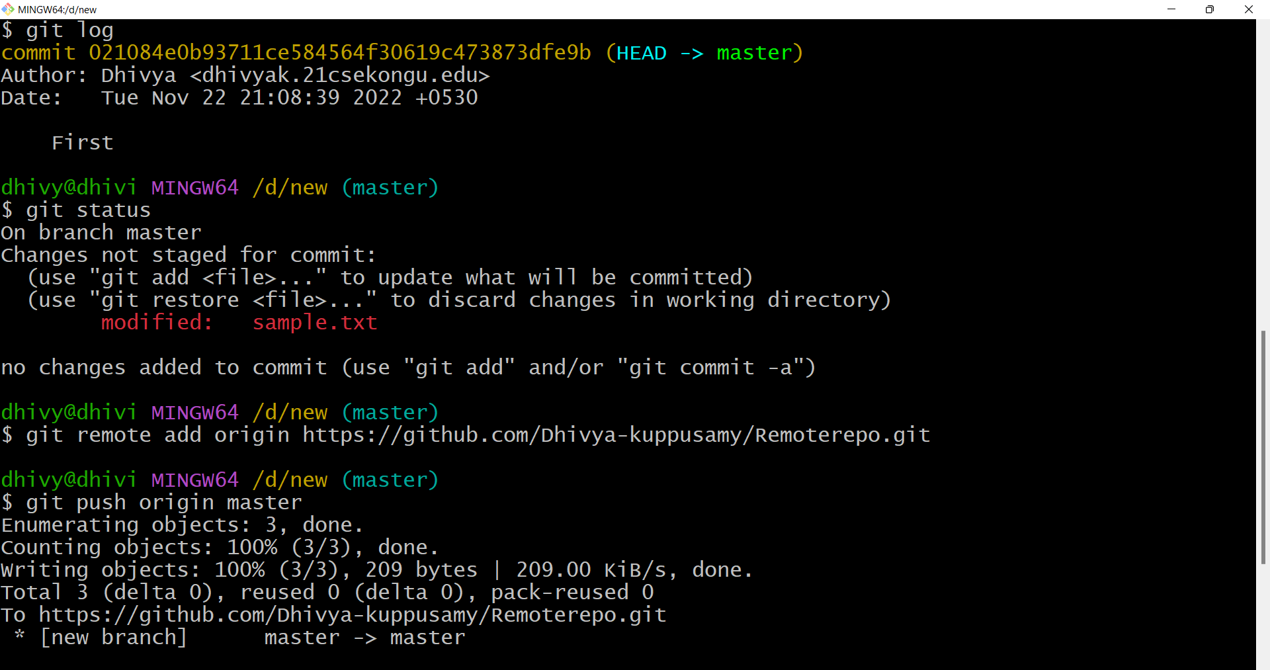
4.Push the file “sample.txt” to “Remoterepo”

Slide 7
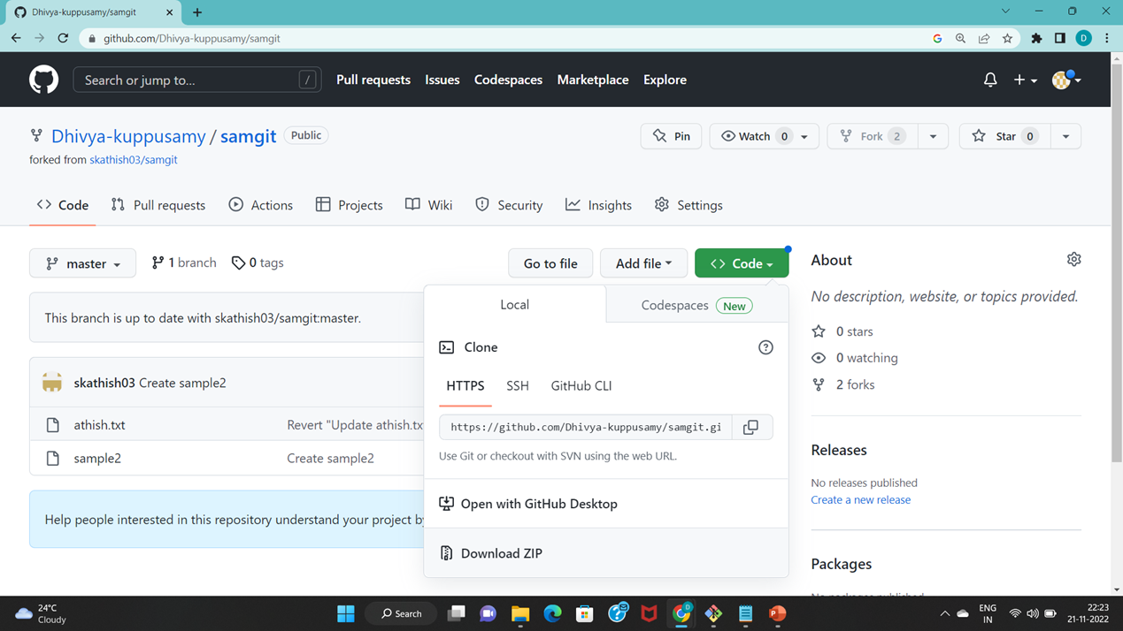
5.Fork some public repository to your github account.

Slide 8
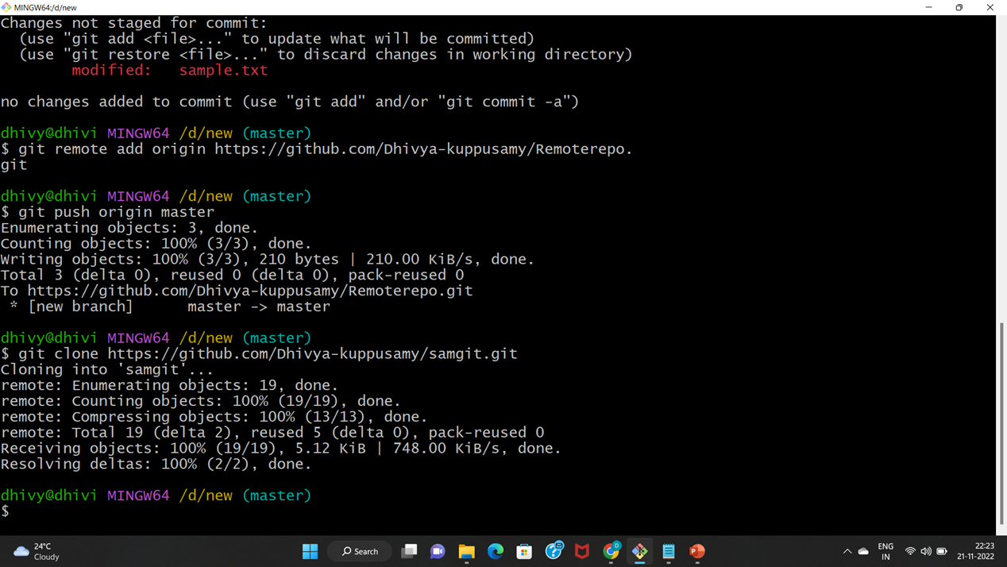
6.Clone the contents of remote repository to your local repository.

Slide 9
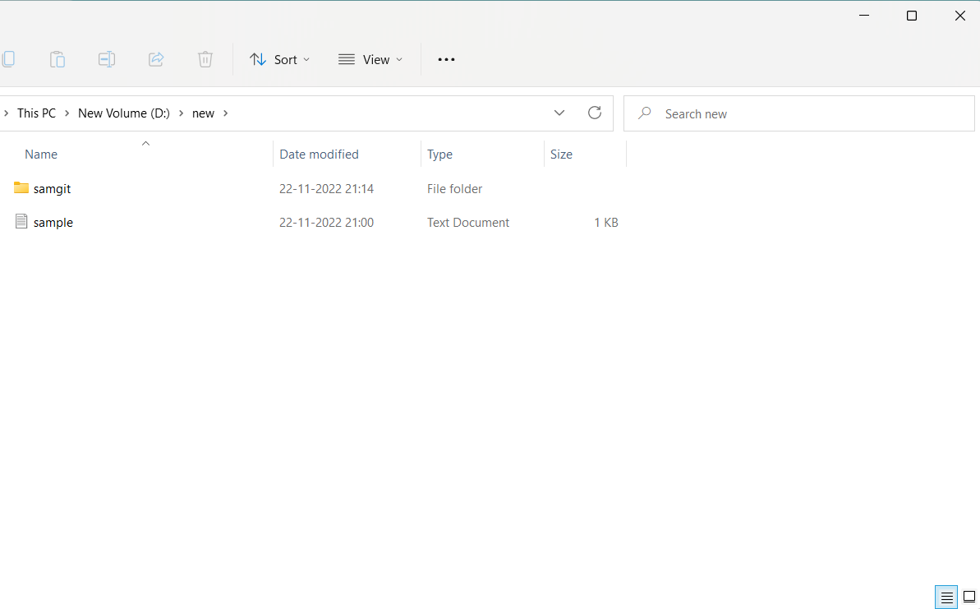

Slide 10
cd: cd command refers to change directory and is used to get into the desired directory
ls: ls command is used to list all the files and folders in the current directory
Initialize the local directory as a Git repository
git init
Stage the files for the first commit by adding them to the local repository
git add file
git commit –m “First”

Slide 11
Commit the files that you’ve staged in your local repository
To display the state of working directory and staging area
git status
add the URL for your repository where your local repository will be pushed
git remote add origin repository_url
git push origin master
A fork is a copy of a repository that you manage.Forks let you make changes to a project without affecting the original repository .you can fetch updates from or submit changes to the original repository with pull requests.
git clone url

Slide 12
THANKYOU…..

